Slide 1
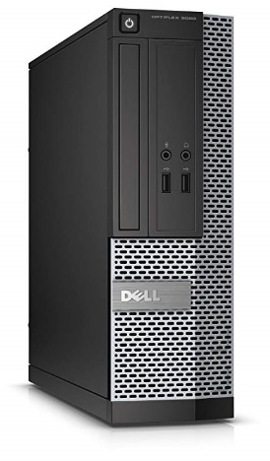

Feature List
List of feature of this custom built PC:
Tower - CAD $458.03 + tax Newegg
Intel Core i5 3.2 GHz
12 GB DDR3
500 GB HDD
Windows 10 Home
Intel HD Graphics
20" LED HD+ monitor high resolution 1600 x 900
2 x HDMI Ports ( Convertible to DVI )
Fast response time 5ms
VESA wall mount ready
Build in speakers
Mounting type: VESA Wall Mount Hole Pattern 75mm x 75mm
Gaming Keyboard and Mouse :Simultaneous operation of up to 19 keys without conflict, 8 multimedia keys, interchangeable "WASD" keys and WIN keys can be disabled for gaming. Gaming mouse with 7 circular breathing color: Red, Green, Blue, Yellow, Purple, Cyan, Pink. Backlit Gaming Keyboard: Gaming keyboard rainbow of LED Backlit can switch among medium light, high light, breath mode and turn off by pressing Fn and Esc simultaneously. Computer keyboards work seamlessly with your game.
Gaming Mouse: Resolution of mice up to 2400DPI, 800/1200/1600/2400DPI adjustable. The ergonomic gaming mouse with DPI switch flashing indicator. PC Gaming Mouse And Keyboard Compatibility: Compatibility with Windows Mac / Win10 / Win8 / Win7 / Vista / 2003 / 2000/ XP / OS for gaming pc.
Main functions of this HP compact color printer: print, scan, copy, wireless printing, AirPrint, Instant Ink ready so you'll never run out of ink, and more
Mobile printing: print and scan on the go with the HP All-in-One Printer Remote app, easily print from your iPhone with AirPrint
HP Printer Compatibility: HP DeskJet 2625, 2652, 2655, 3720, 3722, 3723, 3752, 3755, 3758
Colour: Black, tri-colour
Cartridge yield (approx.) per cartridge: 120 pages black, 100 pages tri-colour
8-1/2" x 11"
92 Bright
500 sheets per ream
Business Computer
By: Dilpreet.C
Purpose
This computer build is primarily designed for an office worker, with some added features to make their work experience slightly more comfortable when getting their work done.
Notes:
To change this brochure, replace our sample content with your own. Or, if you'd rather start from a clean slate, press the New Slide button on the Home tab to insert a new page. Now enter your text and pictures in the empty placeholders. To change the logo to your own, select the picture “replace with LOGO” and choose Change Picture on the Picture Tools Format tab.
And did you notice we made fold marks for you? They are really light, but if you don’t like them showing on your brochure, select and delete them before you print.

Slide 2
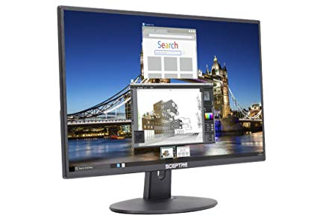
Reasoning
Build
Price Comparisons
Dell OptiPlex 3020 SFF/Core i5-4570 @ 3.2 GHz/12GB DDR3/500GB HDD/DVD-RW/WINDOWS 10 HOME 64 BIT
Sceptre E205W-1600 20" 75Hz Ultra-Thin LED Monitor HDMI VGA Build-in Speakers, Metallic Black (2018 version)
Havit Keyboard Rainbow Backlit Wired Gaming Keyboard Mouse Combo, LED 104 Keys USB Ergonomic Wrist Rest Keyboard, 3200DPI 6 Button Mouse for Windows PC Gamer Desktop, Computer (Black)
HP DeskJet 2655 All-in-One Compact Printer, Instant Ink ready - White (V1N04A)
HP T0A36AN#140 65 Black & Tri-color Original Ink Cartridges, 2 Cartridges (N9K01AN, N9K02AN)
Printing Paper
Tower – I picked Newegg as the provider due it selling in CAD.
Newegg – CAD 458.03 + tax
Amazon – USD 224.50 + tax
Monitor – In this case, it was Amazon which dealt the transaction on CAD.
Walmart – USD $67.00 + tax
Amazon – CAD $128.03 + tax
Keyboard & Mouse – Amazon both had a price in CAD, as well as having a set price, unlike the range of prices which was given by Havit.
Havit – USD $28.00 - $57.00 + tax
Amazon - CAD $39.00 + tax
Printer – Amazon had a price in CAD.
Best Buy – USD $40.00 + tax
Amazon – CAD $80.00 + tax
Printer Cartridge – Amazon was cheaper.
Staples – CAD $41.00 +tax
Amazon – CAD $34.20 + tax
Printer Paper – No difference in either products as they both give the same quality, quantity, and price. So I picked staples.
Walmart – CAD 7.00 + tax
Staples - CAD 7.00 + tax
For an office computer not much power is required, but when researching parts, I learnt that each part can go well over several hundred dollars, therefore when finding components, I had attempted to merge as many components as possible into one purchase. For example, the tower has the CPU, Motherboard, RAM, HDD, Audio Graphics, and case all preset along with Windows 10 OS, which individually would have cost around $800 depending on where you buy from, but in this case I got them altogether for just a little under $460, which is a lot cheaper than individually hunting down parts, as well as the components preloaded are all fairly powerful for the final price being set, giving value for your money. As for the other components, I had attempted to find cheap but effective peripherals, so the mouse and keyboard came together for a little under $40 with the added bonus of being lower end quality for gaming, which automatically makes it higher quality than most regular keyboards and mice with more ergonomic mouse and keyboard feel at an economic price. As for the monitor, when searching most monitors came at $150 or higher, so the monitor selected is cheaper than most whilst also having about as many feature as them and doing the basic job required of it an business environment. Finally, the printer. In a business, a person is often found printing important documents. Therefore, I had added a printer, a cartridge, and printing paper so the worker in question could have a personal printer so he/she would spend less time waiting for their print job at the shared public printer in their office.
Notes:
To change this brochure, replace our sample content with your own. Or, if you'd rather start from a clean slate, press the New Slide button on the Home tab to insert a new page. Now enter your text and pictures in the empty placeholders. To change the logo to your own, select the picture “replace with LOGO” and choose Change Picture on the Picture Tools Format tab.
And did you notice we made fold marks for you? They are really light, but if you don’t like them showing on your brochure, select and delete them before you print.

